Slide 1
Sequential Circuits
Part 4

Slide 2
TOPICS COVERED SO FAR

Slide 3
Topics Covered So Far
Sequential Circuit Elements
SR Latch
Truth Table
Trigger
Level Trigger and Edge Trigger
SR , D and T Flip Flop
Truth Table, Characteristics Table and Excitation Table
JK Flip Flop
Truth Table, Characteristics Table and Excitation Table
Racing Problem
Master Slave JK Flip Flop
Sequential Circuit Design
Circuit Behavior -> Circuit
State table to circuit
State Diagram to state table to circuit

Slide 4
A FEW MORE TERMINOLOGIES

Slide 5
A Few More Terminologies
Mealy Machine and Moore Machine
Output function (Mealy) Outputs = g(Inputs, State)
Output function (Moore) Outputs = h(State)

Slide 6
A Few More Terminologies
Mealy Machine and Moore Machine
Output function (Mealy) Outputs = g(Inputs, State)
Output function (Moore) Outputs = h(State)
Sequential Circuit
Q_{Bn}
Q_{An}
x
g = x + Q_{An}+ Q_{An} Q_{Bn}

Slide 7
A Few More Terminologies
Mealy Machine and Moore Machine
Output function (Mealy) Outputs = g(Inputs, State)
Output function (Moore) Outputs = h(State)
Sequential Circuit
Q_{Bn}
Q_{An}
x
g = x + Q_{An}+ Q_{An} Q_{Bn}

Slide 8
A Few More Terminologies
Mealy Machine and Moore Machine
Output function (Mealy) Outputs = g(Inputs, State)
Output function (Moore) Outputs = h(State)
Sequential Circuit
Q_{Bn}
Q_{An}
x
h = Q_{An}+ Q_{An} Q_{Bn}

Slide 9
A Few More Terminologies
Synchronous Circuit and Asynchronous Circuit
Depends on the times at which:
storage elements observe their inputs, and
storage elements change their state
Synchronous
Behavior defined from knowledge of its signals at discrete instances of time
Storage elements observe inputs and can change state only in relation to a timing signal (clock pulses from a clock)
Asynchronous
Behavior defined from knowledge of inputs an any instant of time and the order in continuous time in which inputs change
If clock just regarded as another input, all circuits are asynchronous!
Nevertheless, the synchronous abstraction makes complex designs tractable!

Slide 10
Formulation: Finding a State Diagram
A state is an abstraction of the history of the past applied inputs to the circuit (including power-up reset or system reset).
The interpretation of “past inputs” is tied to the synchronous operation of the circuit. E. g., an input value (other than an asynchronous reset) is measured only during the setup-hold time interval for an edge-triggered flip-flop.
Examples:
State A represents the fact that a 1 input has occurred among the past inputs.
State B represents the fact that a 0 followed by a 1 have occurred as the most recent past two inputs.

Slide 11
Formulation: Finding a State Diagram
In specifying a circuit, we use states to remember meaningful properties of past input sequences that are essential to predicting future output values.
A sequence recognizer is a sequential circuit that produces a distinct output value whenever a prescribed pattern of input symbols occur in sequence, i.e, recognizes an input sequence occurence.
We will develop a procedure specific to sequence recognizers to convert a problem statement into a state diagram.
Next, the state diagram, will be converted to a state table from which the circuit will be designed.

Slide 12
Sequence Recognizer Procedure
To develop a sequence recognizer state diagram:
Begin in an initial state in which NONE of the initial portion of the sequence has occurred (typically “reset” state).
Add a state that recognizes that the first symbol has occurred.
Add states that recognize each successive symbol occurring.
The final state represents the input sequence (possibly less the final input value) occurence.
Add state transition arcs which specify what happens when a symbol not in the proper sequence has occurred.
Add other arcs on non-sequence inputs which transition to states that represent the input subsequence that has occurred.
The last step is required because the circuit must recognize the input sequence regardless of where it occurs within the overall sequence applied since “reset.”.

Slide 13
A PRACTICAL EXAMPLE OF SEQUENTIAL CIRCUIT
Sequence Recognizer

Slide 14
Sequence Recognizer
Example: Recognize the sequence 1010
Sequence Recognizer Circuit
X= 0 0 1 1 0 1 0 1 0 0 0
Y= 0 0 0 0 0 0 1 0 1 0 0
x
y

Slide 15
Sequence Recognizer Example
Example: Recognize the sequence 1101
Note that the sequence 1111101 contains 1101 and "11" is a proper sub-sequence of the sequence.
Thus, the sequential machine must remember that the first two one's have occurred as it receives another symbol.
Also, the sequence 1101101 contains 1101 as both an initial subsequence and a final subsequence with some overlap, i. e., 1101101 or 1101101.
And, the 1 in the middle, 1101101, is in both subsequences.
The sequence 1101 must be recognized each time it occurs in the input sequence.

Slide 16
Sequence Recognizer
Example: Recognize the sequence 1101
Sequence Recognizer Circuit
X= 0 0 1 1 0 1 1 0 1 0 0
Y= 0 0 0 0 0 1 0 0 1 0 0
x
y

Slide 17
Sequence Recognizer
We need to develop a sequential circuit.
We can develop a sequential circuit if we have the state table or the state diagram
We then have to
select a flip flop
find out the equations for the flip flop inputs and output
Design the circuit
Let us follow the above steps for the sequence 1101

Slide 18
Sequence Recognizer Example
Example: Recognize the sequence 1101
Note that the sequence 1111101 contains 1101 and "11" is a proper sub-sequence of the sequence.
Thus, the sequential machine must remember that the first two one's have occurred as it receives another symbol.
Also, the sequence 1101101 contains 1101 as both an initial subsequence and a final subsequence with some overlap, i. e., 1101101 or 1101101.
And, the 1 in the middle, 1101101, is in both subsequences.
The sequence 1101 must be recognized each time it occurs in the input sequence.

Slide 19
Example: Recognize 1101
Define states for the sequence to be recognized:
assuming it starts with first symbol,
continues through each symbol in the sequence to be recognized, and
uses output 1 to mean the full sequence has occurred,
with output 0 otherwise.
Starting in the initial state (Arbitrarily named "A"):
Add a state that recognizes the first "1."
State "A" is the initial state, and state "B" is the state which represents the fact that the "first" one in the input subsequence has occurred. The output symbol "0" means that the full recognized sequence has not yet occurred.
1/0
A
B

Slide 20
Example: Recognize 1101 (continued)
After one more 1, we have:
C is the state obtained when the input sequence has two "1"s.
Finally, after 110 and a 1, we have:
Transition arcs are used to denote the output function (Mealy Model)
Output 1 on the arc from D means the sequence has been recognized
To what state should the arc from state D go? Remember: 1101101 ?
Note that D is the last state but the output 1 occurs for the input applied in D. This is the case when a Mealy model is assumed.
A
1/0
1/0
B
C
1/0
1/0
0/0
1/1
A
B
C
D

Slide 21
Example: Recognize 1101 (continued)
1/0
1/0
0/0
1/1
A
B
C
D
Clearly the final 1 in the recognized sequence 1101 is a sub-sequence of 1101. It follows a 0 which is not a sub-sequence of 1101. Thus it should represent the same state reached from the initial state after a first 1 is observed. We obtain:
1/0
1/0
0/0
A
B
C
D
1/1

Slide 22
Example: Recognize 1101 (continued)
1/0
1/0
0/0
A
B
C
D
1/1
The state have the following abstract meanings:
A: No proper sub-sequence of the sequence has occurred.
B: The sub-sequence 1 has occurred.
C: The sub-sequence 11 has occurred.
D: The sub-sequence 110 has occurred.
The 1/1 on the arc from D to B means that the last 1 has occurred and thus, the sequence is recognized.

Slide 23
Example: Recognize 1101 (continued)
The other arcs are added to each state for inputs not yet listed. Which arcs are missing?
Answer:
"0" arc from A "0" arc from B "1" arc from C "0" arc from D.
1/0
1/0
0/0
A
B
C
D
1/1

Slide 24
Example: Recognize 1101 (continued)
State transition arcs must represent the fact that an input subsequence has occurred. Thus we get:
Note that the 1 arc from state C to state C implies that State C means two or more 1's have occurred.
0/0
1/0
1/0
B
1/0
0/0
A
A
B
C
D
C
0/0
1/1
0/0

Slide 25
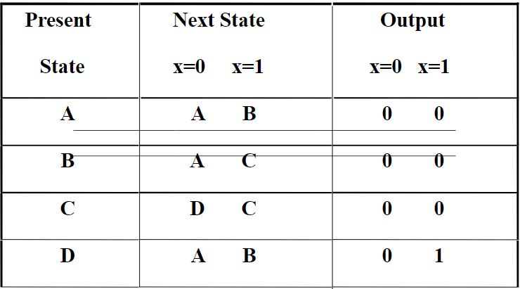
Example: Recognize 1101 (continued)

Slide 26
Formulation: Find State Table
From the State Diagram, we can fill in the State Table.
0/0
0/0
1/0
S0
1/0
S1
1/0
0/0
1/0
S2
S3
SSA
B
C
D
0/0
1/1
0/0

Slide 27

State Assignment 1 – Example 1 (continued)
Assignment 1: A = 0 0, B = 0 1, C = 1 0, D = 1 1
The resulting coded state table:
0/0
0/0
1/0
00
1/0
1/0
0/0
1/0
01
10
11
B
C
D
Present State | Next State x = 0 x = 1 |  | Output x = 0 x = 1
0 0 | 0 0 | 0 1 | 0 | 0
0 1 | 0 0 | 1 0 | 0 | 0
1 0 | 1 1 | 1 0 | 0 | 0
1 1 | 0 0 | 0 1 | 0 | 1
0/0
1/1
0/0

Slide 28
State Assignment – Example 2 (continued)
Assignment 2: A = 0 0, B = 0 1, C = 1 1, D = 1 0
The resulting coded state table:
Present State | Next State x = 0 x = 1 |  | Output x = 0 x = 1
0 0 | 0 0 | 0 1 | 0 | 0
0 1 | 0 0 | 1 1 | 0 | 0
1 1 | 1 0 | 1 1 | 0 | 0
1 0 | 0 0 | 0 1 | 0 | 1

Slide 29
Sequence Recognizer
Design a sequence recognizer to detect the sequence 11011

Slide 30
Sequence Recognizer
Design a sequence recognizer to detect the sequence 11011
Step 1 – Derive the State Diagram and State Table for the Problem
Step 1a – Determine the Number of States
We are designing a sequence detector for a 5-bit sequence, so we need 5 states. We label these states A, B, C, D, and E. State A is the initial state.
Step 1b – Characterize Each State by What has been Input and What is Expected
State Has Awaiting A -- 11011
B 1 1011
C 11 011
D 110 11
E 1101 1

Slide 31
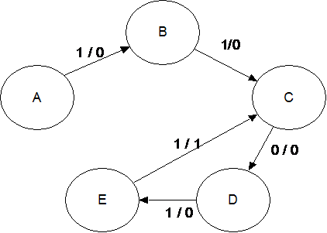
Sequence Recognizer
Design a sequence recognizer to detect the sequence 11011
Step 1c – Do the Transitions for the Expected Sequence

Slide 32
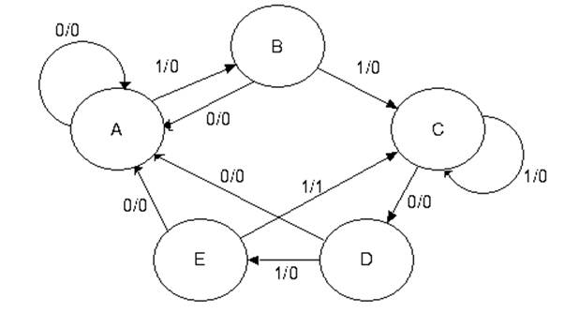
Sequence Recognizer
Design a sequence recognizer to detect the sequence 11011
Step 1d – Insert the Inputs That Break the Sequence

Slide 33
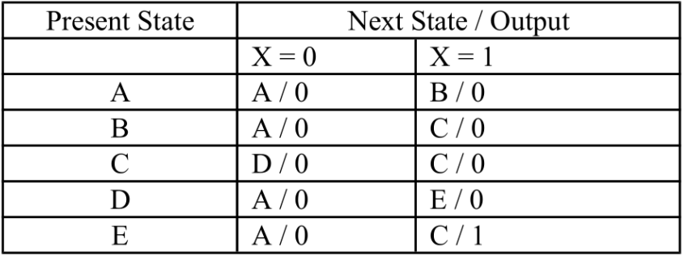
Sequence Recognizer
Design a sequence recognizer to detect the sequence 11011
Step 1d – Insert the Inputs That Break the Sequence

Slide 34
Sequence Recognizer
Design a sequence recognizer to detect the sequence 11011
Step 1e – Generate the State Table with Output
A = 000
B = 001
C = 011 States 010, 110, and 111 are not used.
D = 100
E = 101
Occasionally, a better assignment can be detected by inspection of the next state table. I note that the next states in the table cluster into two disjoint sets for X = 0 and X = 1. For X = 0 the possible next states are A and D For X = 1 the possible next states are B, C, and E. For this reason, I elect to give even number assignments to states A and D, and to give odd number assignments to states B, C, and E.

Slide 35
Sequence Recognizer
Present State |  | Next State / Output |  | Output
 |  | X = 0 | X = 1 | X = 0 | X = 1
 | Q₂Q₁Q₀ | Q₂Q₁Q₀ | Q₂Q₁Q₀ | Y | Y
A | 0 0 0 | 0 0 0 | 0 0 1 | 0 | 0
B | 0 0 1 | 0 0 0 | 0 1 1 | 0 | 0
C | 0 1 1 | 1 0 0 | 0 1 1 | 0 | 0
D | 1 0 0 | 0 0 0 | 1 0 1 | 0 | 0
E | 1 0 1 | 0 0 0 | 0 1 1 | 0 | 1

Slide 36
Sequence Recognizer
Step 2 – Determine the Number of Flip-Flops Required
Q(T) Q(T + 1) J K
0 0 0 X
0 1 1 X
1 0 X 1
1 1 X 0
Y = X·Q₂·Q₀
J₂ = X’·Q₁ and K₂ = X’ + Q₀
J₁ = X·Q₀ and K₁ = X’
J₀ = X and K₀ = X’

Slide 37
Sequence Recognizer
Present State |  | Next State / Output |  | Output
 |  | X = 0 | X = 1 | X = 0 | X = 1
 | Q₂Q₁Q₀ | Q₂Q₁Q₀ | Q₂Q₁Q₀ | Y | Y
A | 0 0 0 | 0 0 0 | 0 0 1 | 0 | 0
B | 0 0 1 | 0 0 0 | 0 1 1 | 0 | 0
C | 0 1 1 | 1 0 0 | 0 1 1 | 0 | 0
D | 1 0 0 | 0 0 0 | 1 0 1 | 0 | 0
E | 1 0 1 | 0 0 0 | 0 1 1 | 0 | 1

Slide 38
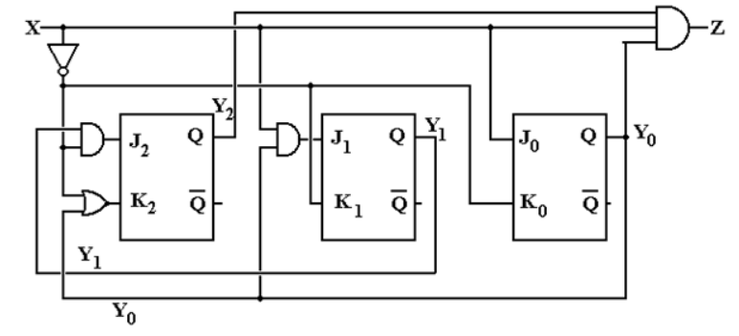
Sequence Recognizer
Design a sequence recognizer to detect the sequence 11011
Y
Q2
Q1
Q0
Q1
Q2

Slide 39
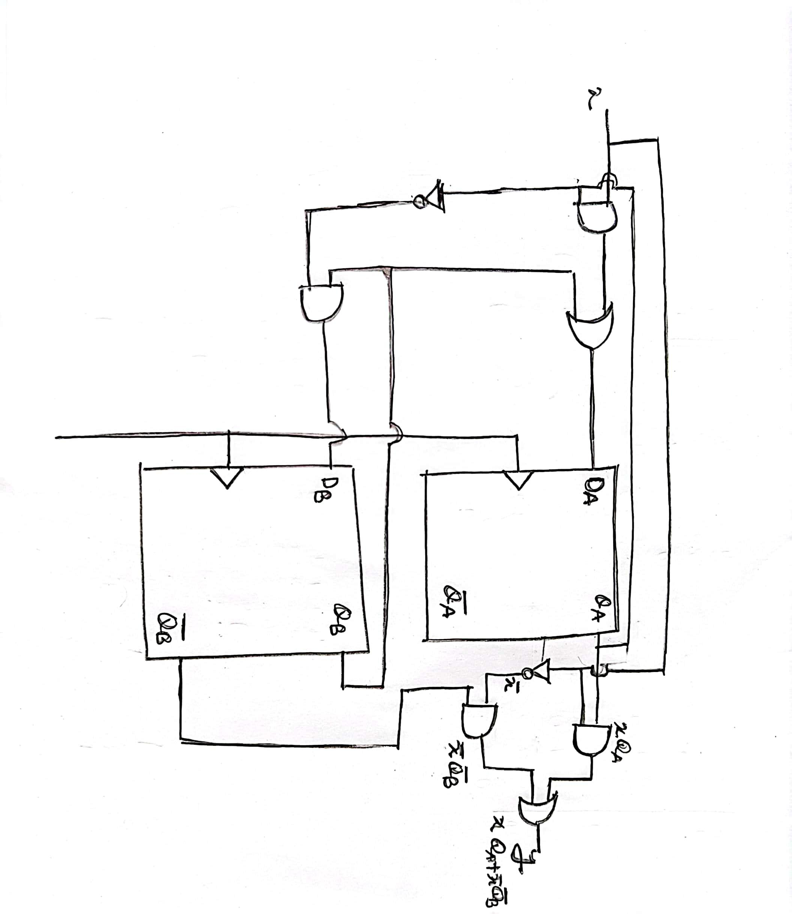
Sequential Circuit to State Diagram

Slide 40
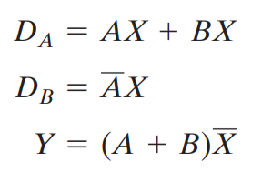
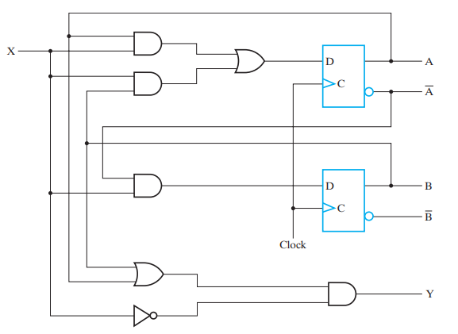
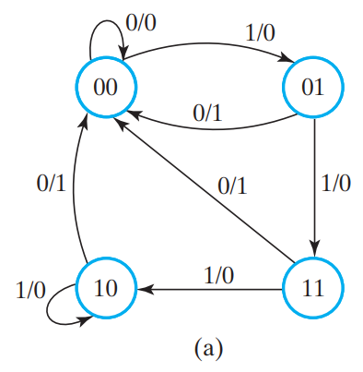
Sequential Circuit to State Diagram

Slide 41
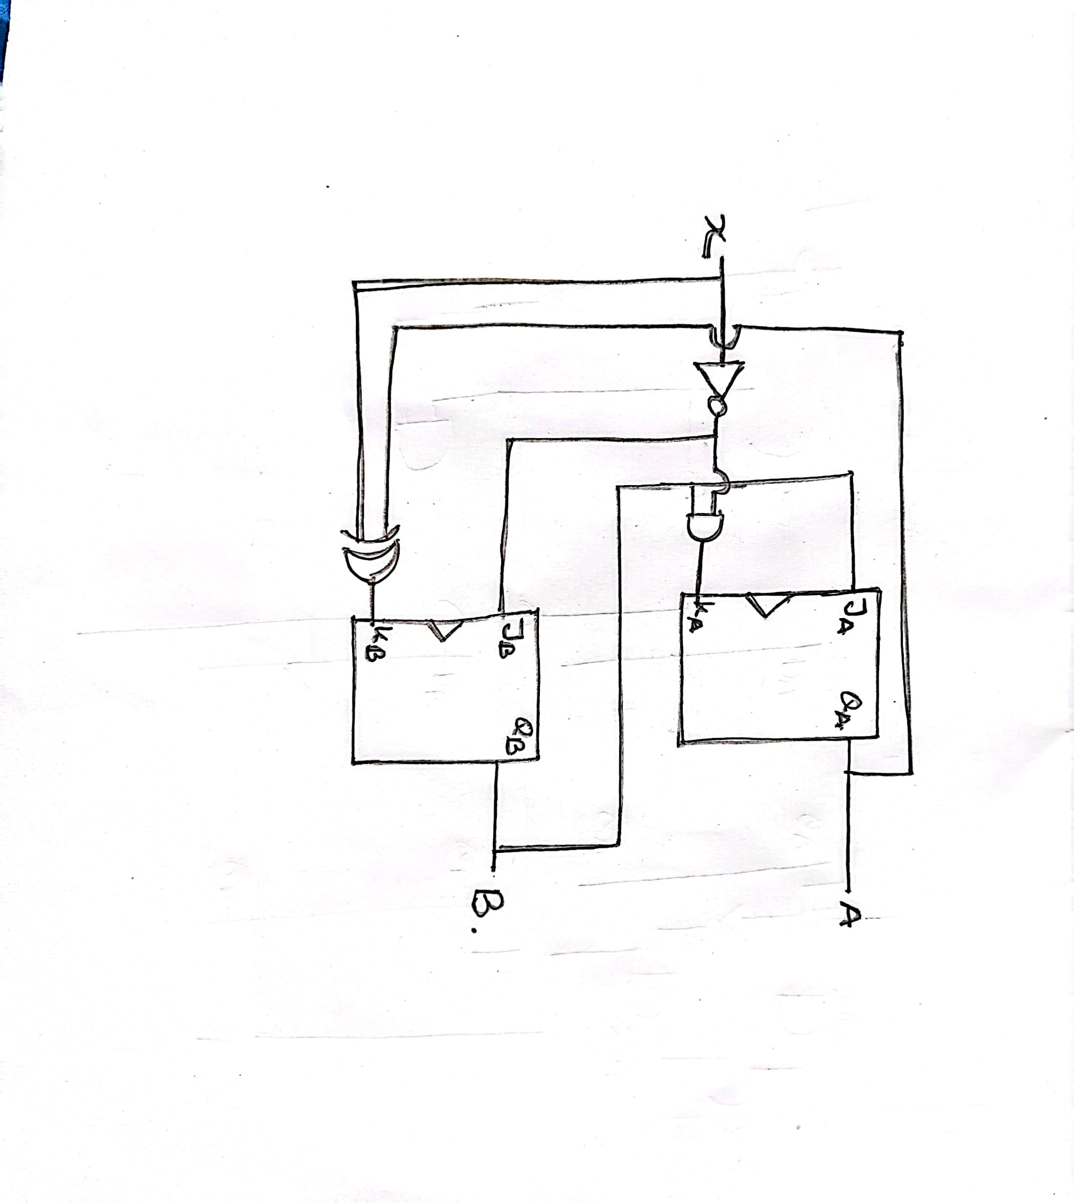
Sequential Circuit to State Diagram

Slide 42
Thank You

